Slide 1

Guideline for the Molecular Testing of Lung Cancers for Treatment with Targeted Therapies – version 3
Neal Lindeman, MD
Vice Chair, Molecular Pathology and Laboratory Medicine
Faculty Distinguished Professor (II) of Pathology
Weill Cornell Medicine
Georgia Society of Clinical Oncology
May 17, 2025
Atlanta, GA

Slide 2

Introductions

Slide 3


Slide 4
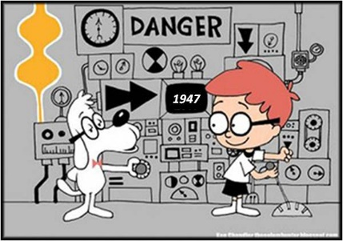
Case Presentation:
52 yr old female
Symptoms (months):
  Headaches
  Light/dark sensitivity
  Chronic dry cough
MRI:
  Enhancing dural mass
Differential Dx:
  Tumor
    Meningioma
    Lymphoma
    Metastasis
    Primary CNS tumor
  Granuloma
    Sarcoidosis
    Tuberculosis
  Chronic meningitis
    Wegener’s

Slide 5

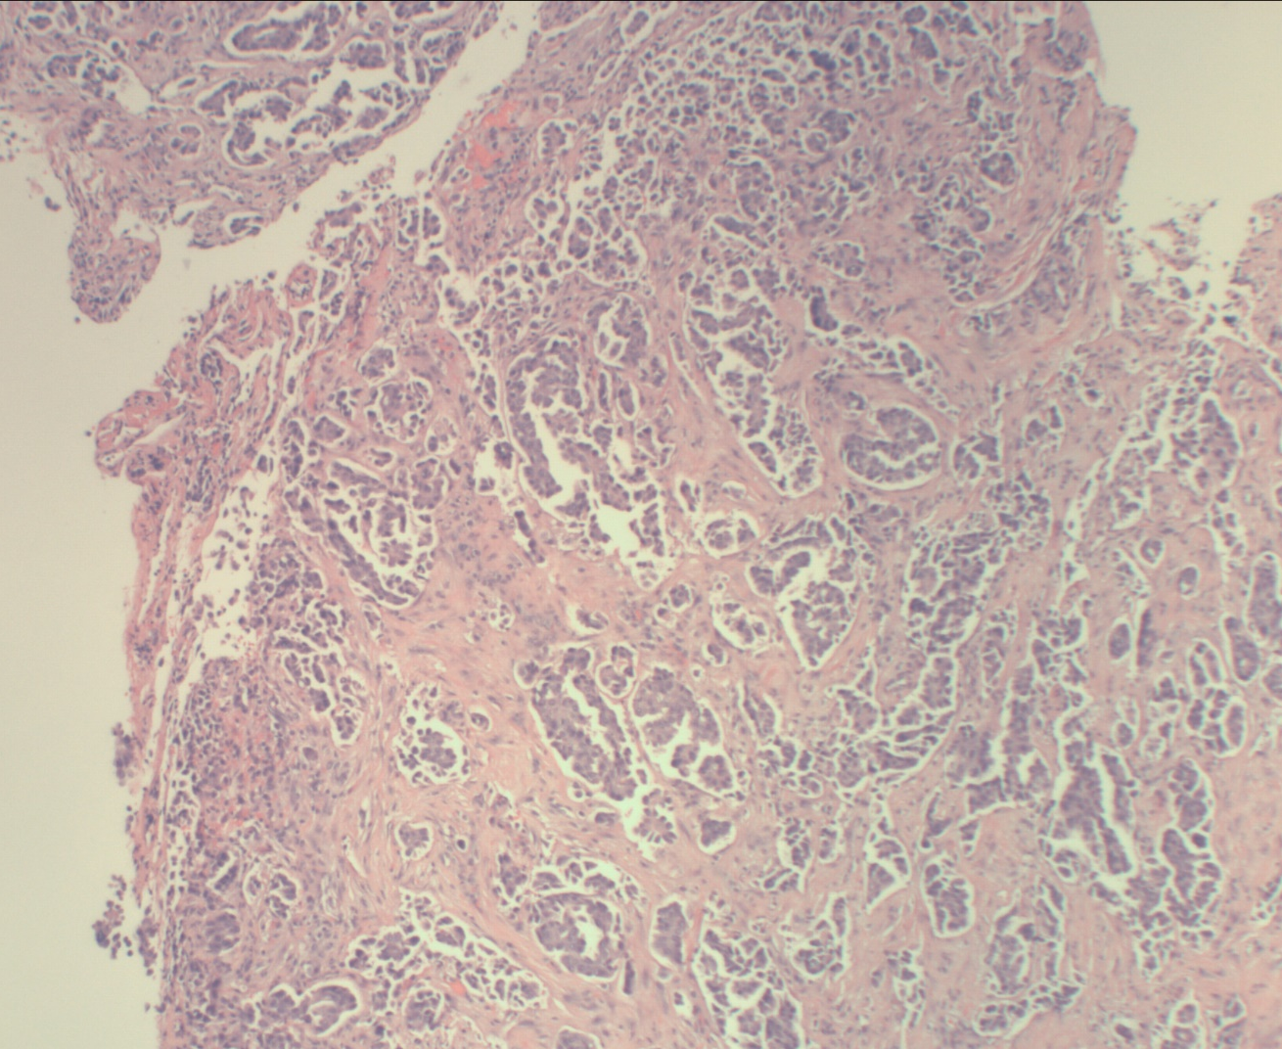
Case presentation:
Brain biopsy:

Slide 6

Case Presentation
Follow-up imaging studies
  5 cm lung mass
  Additional masses:
    Lung (x2), liver (x2), bone
Non-small Cell Lung Cancer, Stage IV

Slide 7

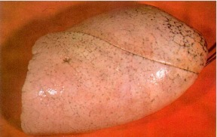
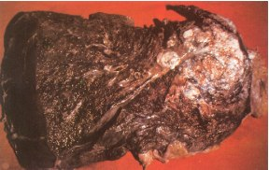
Lung Cancer is Bad
Survival @ 5 years:
  Local: 64%
  RegionaI: 36%
  Distant: 9%
Median survival:
  Stage I/II: 17 – 32 months
  Stage III: 9 - 22 months
  Stage IV: 16 – 36 weeks
Van Gogh, 1885
http://whyquit.com

Slide 8
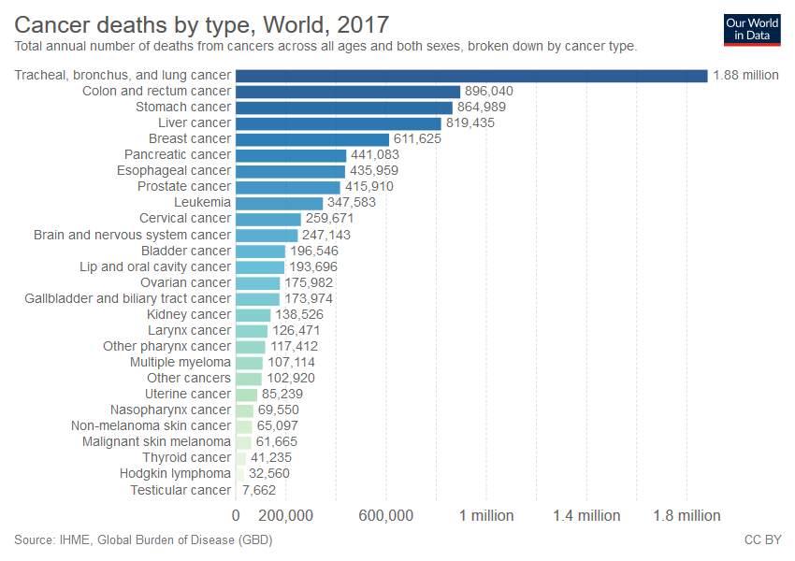
Lung Cancer is Bad for society
20K
40K
60K
80K
100K
120K
140K
160K
Lung
Colorectal
Breast
Pancreas
Prostate
Leukemia
Lymphoma
Liver
Ovary
Bladder
Kidney
CNS
Myeloma
Melanoma
Endometrium
Thyroid

Slide 9

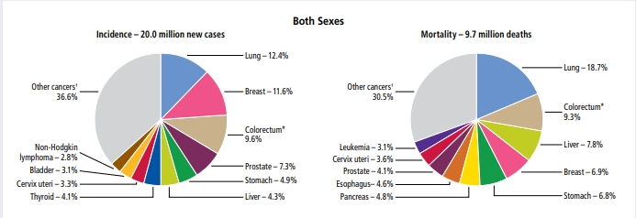
It is getting better…slightly
ACS, Feb 11, 2025
2017: 1.88M deaths
2022: 1.81M deaths

Slide 10
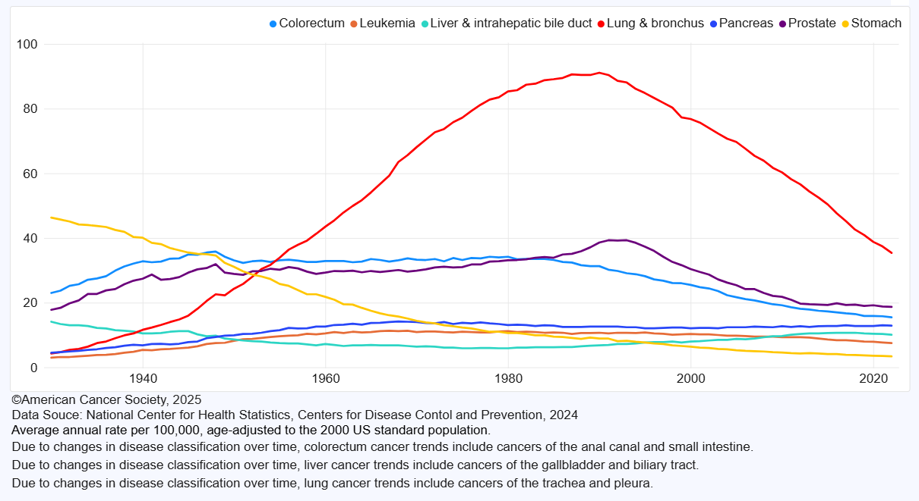
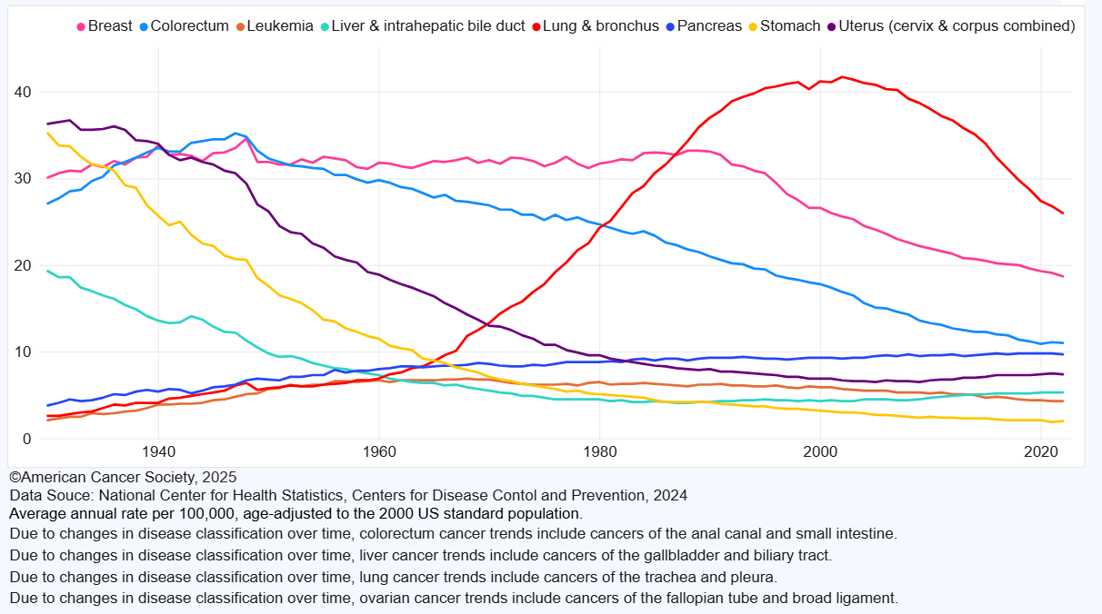
It IS getting better…in the US
Male cancer mortality
Female cancer mortality
American Cancer Society, Feb 11, 2025

Slide 11
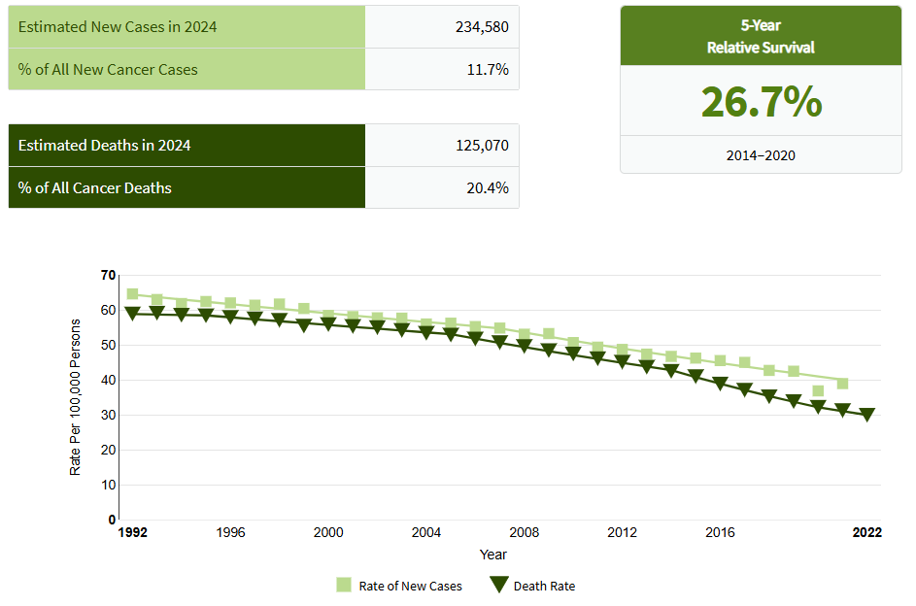
It is getting better…in the US
2015: PD-L1
2004: EGFR
2010: ALK
2013: first guideline
SEER, NIH website, accessed 28/11/2025

Slide 12
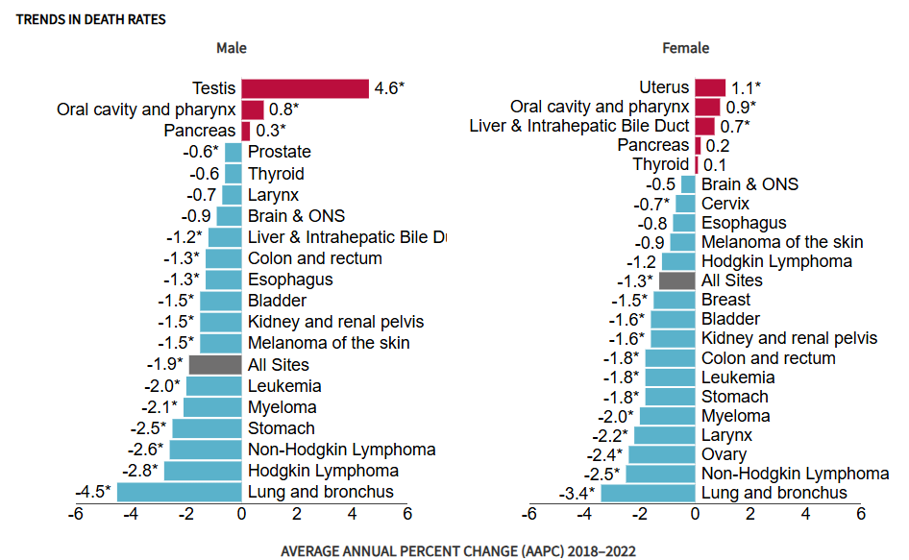
It is getting better…in the US
SEER, NIH website, accessed 2/11/2025

Slide 13
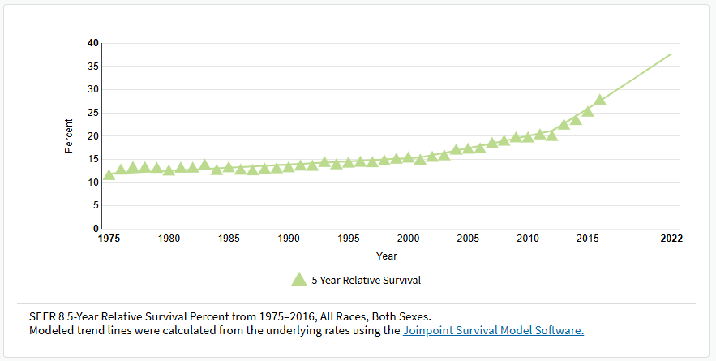
It IS getting better…in the US
SEER, NIH website, accessed 2/11/2025

Slide 14

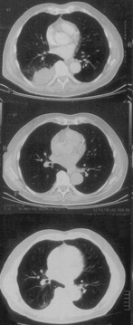
Return to Case:
History:
  Never smoked
  Course:
  4/01: Carboplatin-Paclitaxel
    Response for 6 wks
    Progression by 12/01
  12/01: Cetuximab (Erbitux)
    Stabilization for 4 mos
    Progression by 7/02
  8/02: Gefitinib (Iressa)
    Sustained response for 30 mos
    Relapse in 2/05
8/02
5/03
2/05

Slide 15
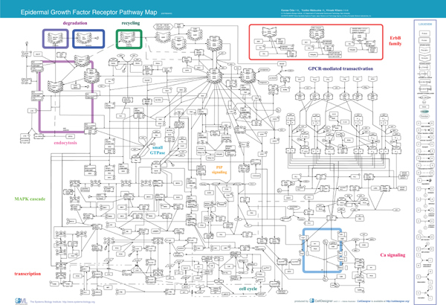
What is EGFR and why target it?
Oda, et al., Molec Systems Biol, 2005

Slide 16

EGFR signaling simplified:
Ligand binds
Receptor Dimerization
Phosphorylation
Downstream signaling
  RAS→RAF→ERK
  JAK→STAT
  PIK3CA→AKT→mTOR
Cells proliferate, survive
Very commonly overexpressed in human carcinomas

Slide 17
How to test for EGFR?
Mol Dx
FISH
IHC

Slide 18
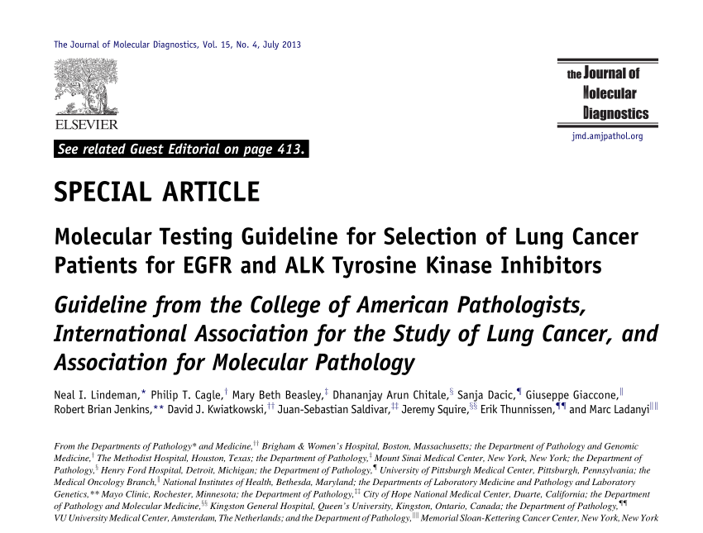
2013: Practice guideline for EGFR and ALK

Slide 19
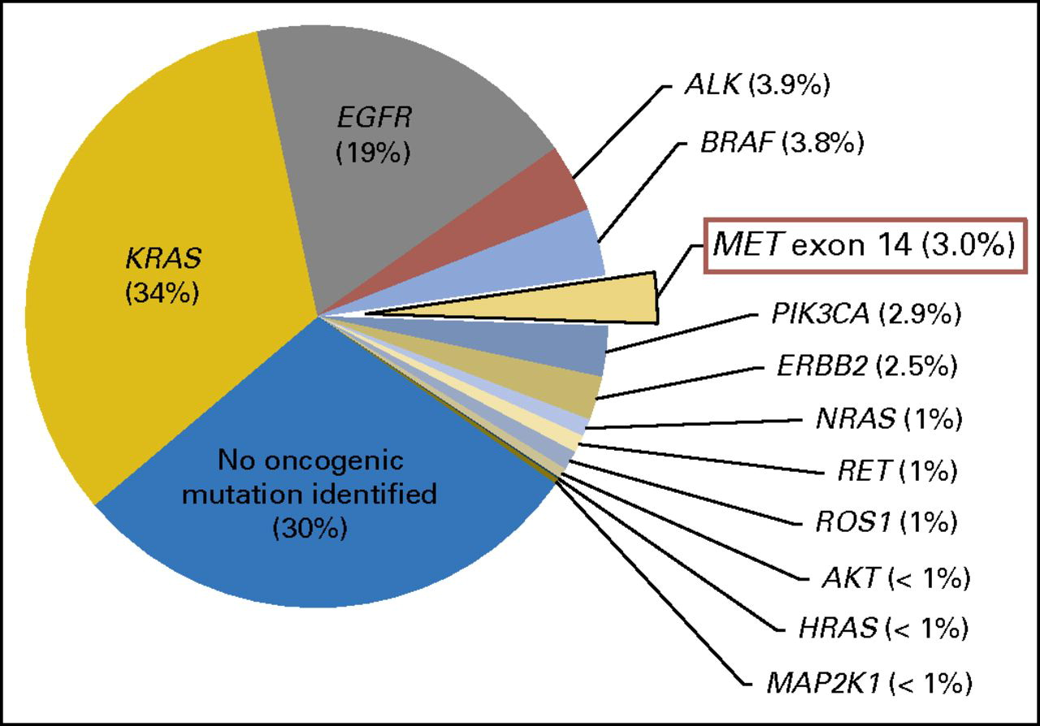
2017:
EGFR/ALK not the whole story
Awad, et al., JCO 2016

Slide 20

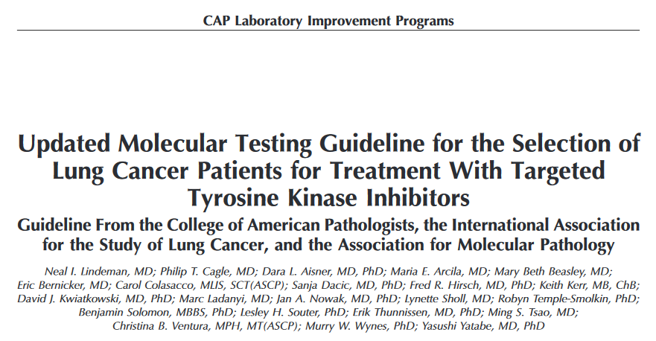
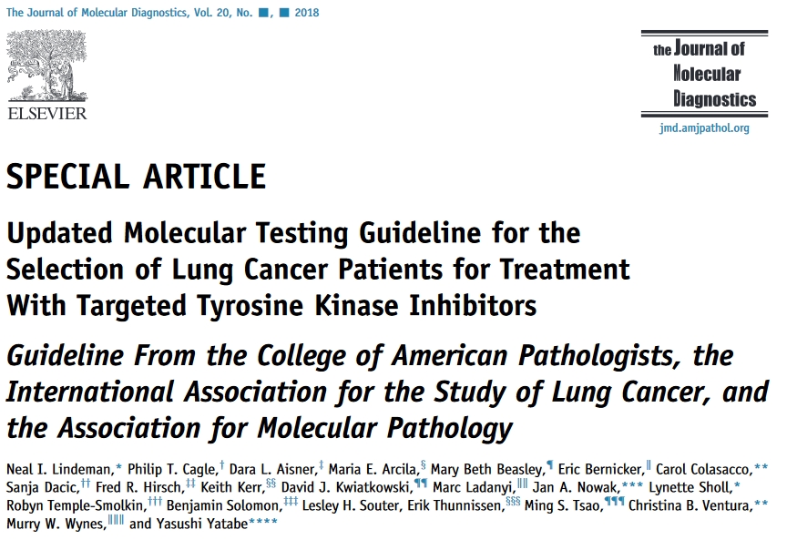
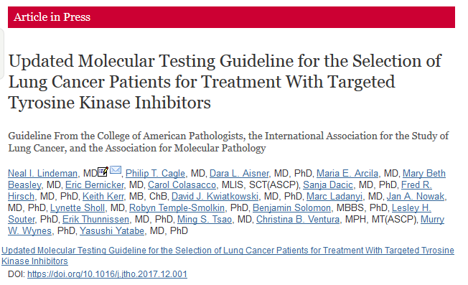

Slide 21
2018 Guideline Conclusions
All advanced NSCLC patients with adeno component should be tested for EGFR, ALK, ROS1
  Add BRAF, ERBB2, MET, RET if doing a large panel
  IHC is acceptable for ALK and screening for ROS1
  No mandate to test squamous or small cell carcinomas
For patients who progress on therapy
  EGFR relapse should be tested for T790 with ultrasensitive method
  ALK/ROS relapse do not need further ALK/ROS testing for management
Cell free DNA is appropriate when biopsy hard to obtain
  If cell free DNA is negative, biopsy is needed
PD1/PDL1 are important, but nonstandardized

Slide 22
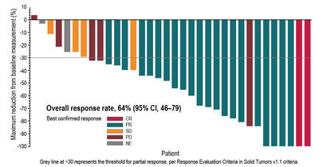
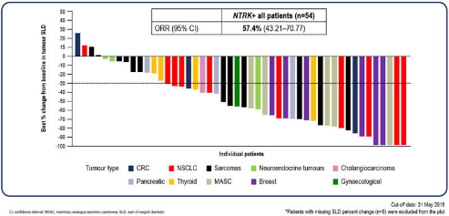
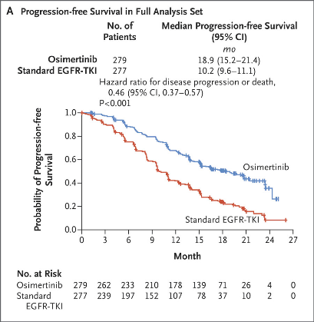
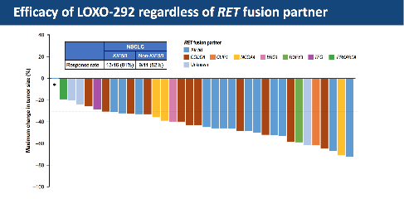
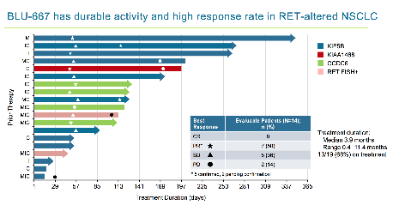
Since the revised guidelines published in 2018:
BRAF testing standard care
NTRK inhibitor approved
EGFR T790M inhibitors now first line
RET inhibitors approved
MET inhibitors approved
Inhibitor for EGFR exon 20 insertions
Immune therapies exploded
KRAS G12C inhibitors
ERBB2 conjugates
Planchard, ESMO, 2017
Demetri, ESMO 2018
Koski, 2018
Soria, et al., NEJM, 2018

Slide 23
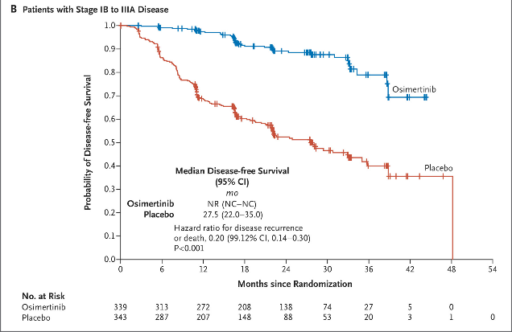
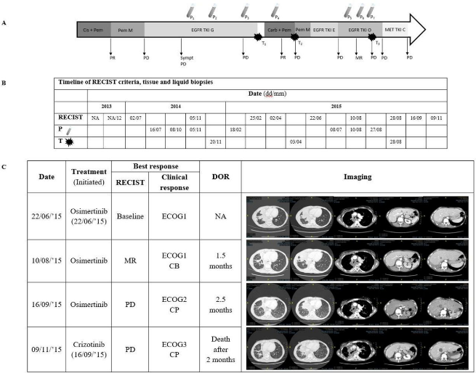
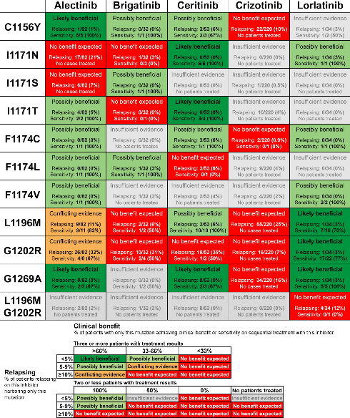
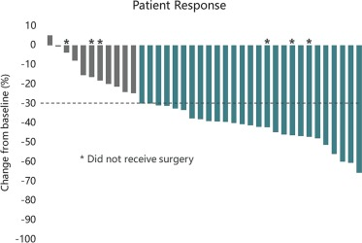
Plus…
Treating early stage
  Neoadjuvant?
Minimal samples
Monitoring therapy
Resistance testing
Non-adenoCa
Wu, et al., NEJM, 2020
Sorber, et al., J Clin Path, 2018
Ly, et al., Lung Cancer, 2021
Koopman, et al., Clin Lung Cancer, 2022

Slide 24

Time for a new guideline

Slide 25
Why Revise the Guideline?
The original guideline was published in 2013.
This was updated and revised in 2018.
There is new evidence on:
  New therapies
  New biomarkers for targeted therapies
  Advances in current and new technologies
Existing guidelines must be updated periodically.
  National Academy of Medicine: every 5 years

Slide 26
First Half of Guideline Development Process Simplified Overview
Organizations Trigger Guideline Update
Develop Timeline Scope and Key Questions
Define Inclusion and Exclusion Criteria
Identify Primary Outcomes
Refine Literature Search
Expert Panel Identified
& Conflict of Interest Management
Systematic Literature Review
Mar
2021
Sept
2023

Slide 27



Guideline Development Team
Advisory Panel Members
Mark G. Kris, MD
Jane Gibson, PhD
Daniel Tan, MD, PhD
Timothy Allen, MD, JD
Antonio Marchetti, MD, PhD
Paul Bunn, MD
Natasha Rekhtman, MD, PhD
Federico Cappuzzo, MD
Tetsuya Mitsudomi, MD, PhD
Yi-long Wu, MD
Kim Norris
Upal Basu Roy, PhD, MPH
Karen Reckamp, MD
Dara L. Aisner, MD, PhD
Jordi Remon, MD, PhD
Fred R. Hirsch, MD, PhD
Christina Lockwood, PhD
Ignacio I. Wistuba, MD
Andrew Ciupek, PhD
Jessica Donington, MD
Ming Sound Tsao, MD
Benjamin Solomon, MBBS, PhD
Julia Bridge, MD
Oscar Arrieta, MD, MSc
Co-Chairs & Steering Committee
Sinchita Roy Chowdhuri, MD, PhD (CAP)
Sanja Dacic, MD, PhD (IASLC)
Neal Lindeman, MD (AMP)
Expert Panel Members
CAP: Sanjay Mukhopadhyay, MD, Mary Beth Beasley, MD, Jason D. Merker, MD, PhD, Eric Bernicker, MD, Paul VanderLaan, MD, PhD
IASLC: Keith Kerr, MD, Yasushi Yatabe, MD, PhD,
Lukas Bubendorf, MD, Christine Lovly, MD, PhD,
Wendy Cooper, MD
AMP: Laura Tafe, MD, Lynette Sholl, MD,
Maria E. Arcila, MD, David Kwiatkowski, MD, PhD,
Dhananjay Chitale, MD
Staff
Christina Ventura, BS, MLS (ASCP) - CAP
Nicole Thomas, MPH – CAP
Carol Colasacco, MLIS, SCT(ASCP) – CAP
Marisol Hernandez, MLS, MA - CAP
Murry Wynes, PhD – IASLC
Casey Connolly, MPH - IASLC
Karen Kelly, MD - IASLC
Robyn Temple-Smolkin, MBA, PhD – AMP
Jacob Ruden, PhD - AMP
Lesley Souter, PhD – Guideline Methodologist

Slide 28

Content of the Current Guideline Update
Old recommendations will be reviewed and modified as needed
New recommendations in five areas:
  Which genes should be tested in lung cancer patients?
  What methods should be used for molecular testing?
  Which histologic types of lung cancer should be tested?
  What to do for patients who have relapsed?
  What is the role of circulating cell free DNA?

Slide 29

Inclusion Criteria
STUDIES MUST:
Include adult patients with a proven or suspected diagnosis of any stage lung adenocarcinoma, adenosquamous, squamous cell, non-small cell lung carcinoma NOS, small cell carcinoma, neuroendocrine, sarcomatoid, pleomorphic, or salivary gland-type carcinoma, who are being considered for molecularly targeted therapies
Include testing of included molecular biomarkers using surgical pathology samples, cytology samples, blood, liquid biopsy, or other fluids
Be peer-reviewed, full-text articles, with primary data, >5/30 patients
AKT1 | ALK | BRAF | DDR2
DLL3 | EGFR | FGFR1-4 | ERBB2 (HER2)
KEAP1 | KRAS | MEK/MAP2K1 | MET
NRG | NTRK1-3 | NUTM1 | PIK3CA
RET | ROS1 | SLFN11 | SMARCA4
STK11 | TP53
Bold = Genes with recommendations in 2018 guideline

Slide 30
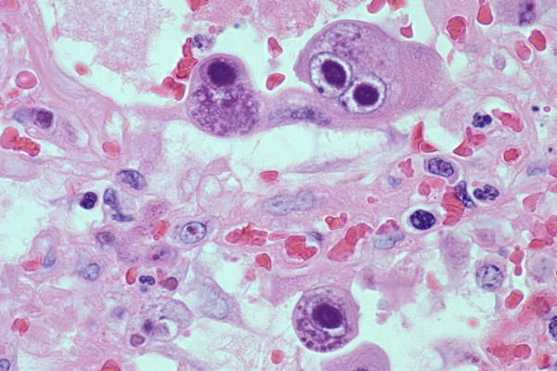
Inclusion Criteria
STUDIES MUST EITHER:
Examine the biomarkers in treatment response and survival rates
Evaluate histologic or clinical characteristics to select patients for molecular testing
Determine the diagnostic test characteristics of biomarker assays

Slide 31
Primary Outcomes
Treatment response rates, time to progression, or survival rates
Diagnostic accuracy for biomarker status or clinical outcome
  Sensitivity, specificity, positive or negative predictive value
Concordance between analytic platforms
Turnaround time, resource requirements, or tissue requirements
Concordance with clinical or radiological progression

Slide 32


What is the role of testing to select patients for treatment with immunomodulatory therapies?
OUT OF SCOPE :
CAP/ASCO/AMP guideline pending on this topic

Slide 33
Systematic Review Included Studies to Date
Title Screen
7832 titles (+ 3054 in literature refresh)
Title Abstract Screening
4108 abstracts (+ 1415 in literature refresh)
Full Text Review
2228 full articles (+ 53 in literature refresh)
Data Extraction
1102 met inclusion criteria; 883 underwent data extraction
Data Tables
>200 studies included in "new biomarkers"
>800 agree with previously drafted recs (2013 and 2018)

Slide 34

Second Half of Guideline Development Process Simplified Overview
Literature Review Data Analysis
Develop Draft Recommendations
Public Open Comment Period
Finalize Manuscript Draft
Advisory Panel Reviews Draft Manuscript
CAP, IASLC, & AMP Manuscript Approval
Joint Journal Peer Review
Publication in all 3 Society Journals
Sep
2023
Targeted for publication Q3 2025 in Archives of Pathology and Laboratory Medicine, Journal of Thoracic Oncology, and The Journal of Molecular Diagnostics

Slide 35
Data Analysis / Draft Recommendations
Split into four teams of Panelists for data review of NEW biomarkers;
  Oncologist on each GeneTeam
Co-chairs review 2018 reaffirmation
GRADE methodology used to weigh evidence
Draft recommendation(s) reviewed in person meeting (Dec, 2023)
  Patient Advocates attended
  Finalized draft recommendations
  Prepared for public open comment period

Slide 36

Online public open comment period
hosted by AMP
concluded in September 2024

Slide 37
Guideline Update Key Questions
In adenocarcinoma patients being considered for molecularly targeted therapies:
  Does biomarker testing improve treatment response rates and survival rates? (KQ1)
  What histopathologic and clinical characteristics should be used to select patients for molecular testing? (KQ2)
In patients diagnosed with lung cancer without an adenocarcinoma component or NSCLC NOS and being considered for molecularly targeted therapies, does biomarker testing improve treatment response rates, survival rates, or diagnostic accuracy? (KQ3)
When conducting lung biomarkers testing, what are the diagnostic test characteristics of the available assays? (KQ4)
In NSCLC patients who have progressed while undergoing treatment with molecularly targeted therapies:
  Should biomarker testing be utilized to guide the next line of therapy? (KQ5)
  What are the preferred resistance mutation detection assays?(KQ6)
In NSCLC patients undergoing treatment with molecularly targeted therapies, should molecular testing be used to monitor for progression? (KQ7)

Slide 38


Slide 39

Which genes should be tested?
EGFR
ALK
ROS1
RET
ERBB2 (HER2)
MET
BRAF
KRAS
NTRK
Emerging biomarkers of interest, not required:
  STK11, TP53, NRG1,PIK3CA, SMARCA4, FGFR1-4, DLL3, NUTM1

Slide 40
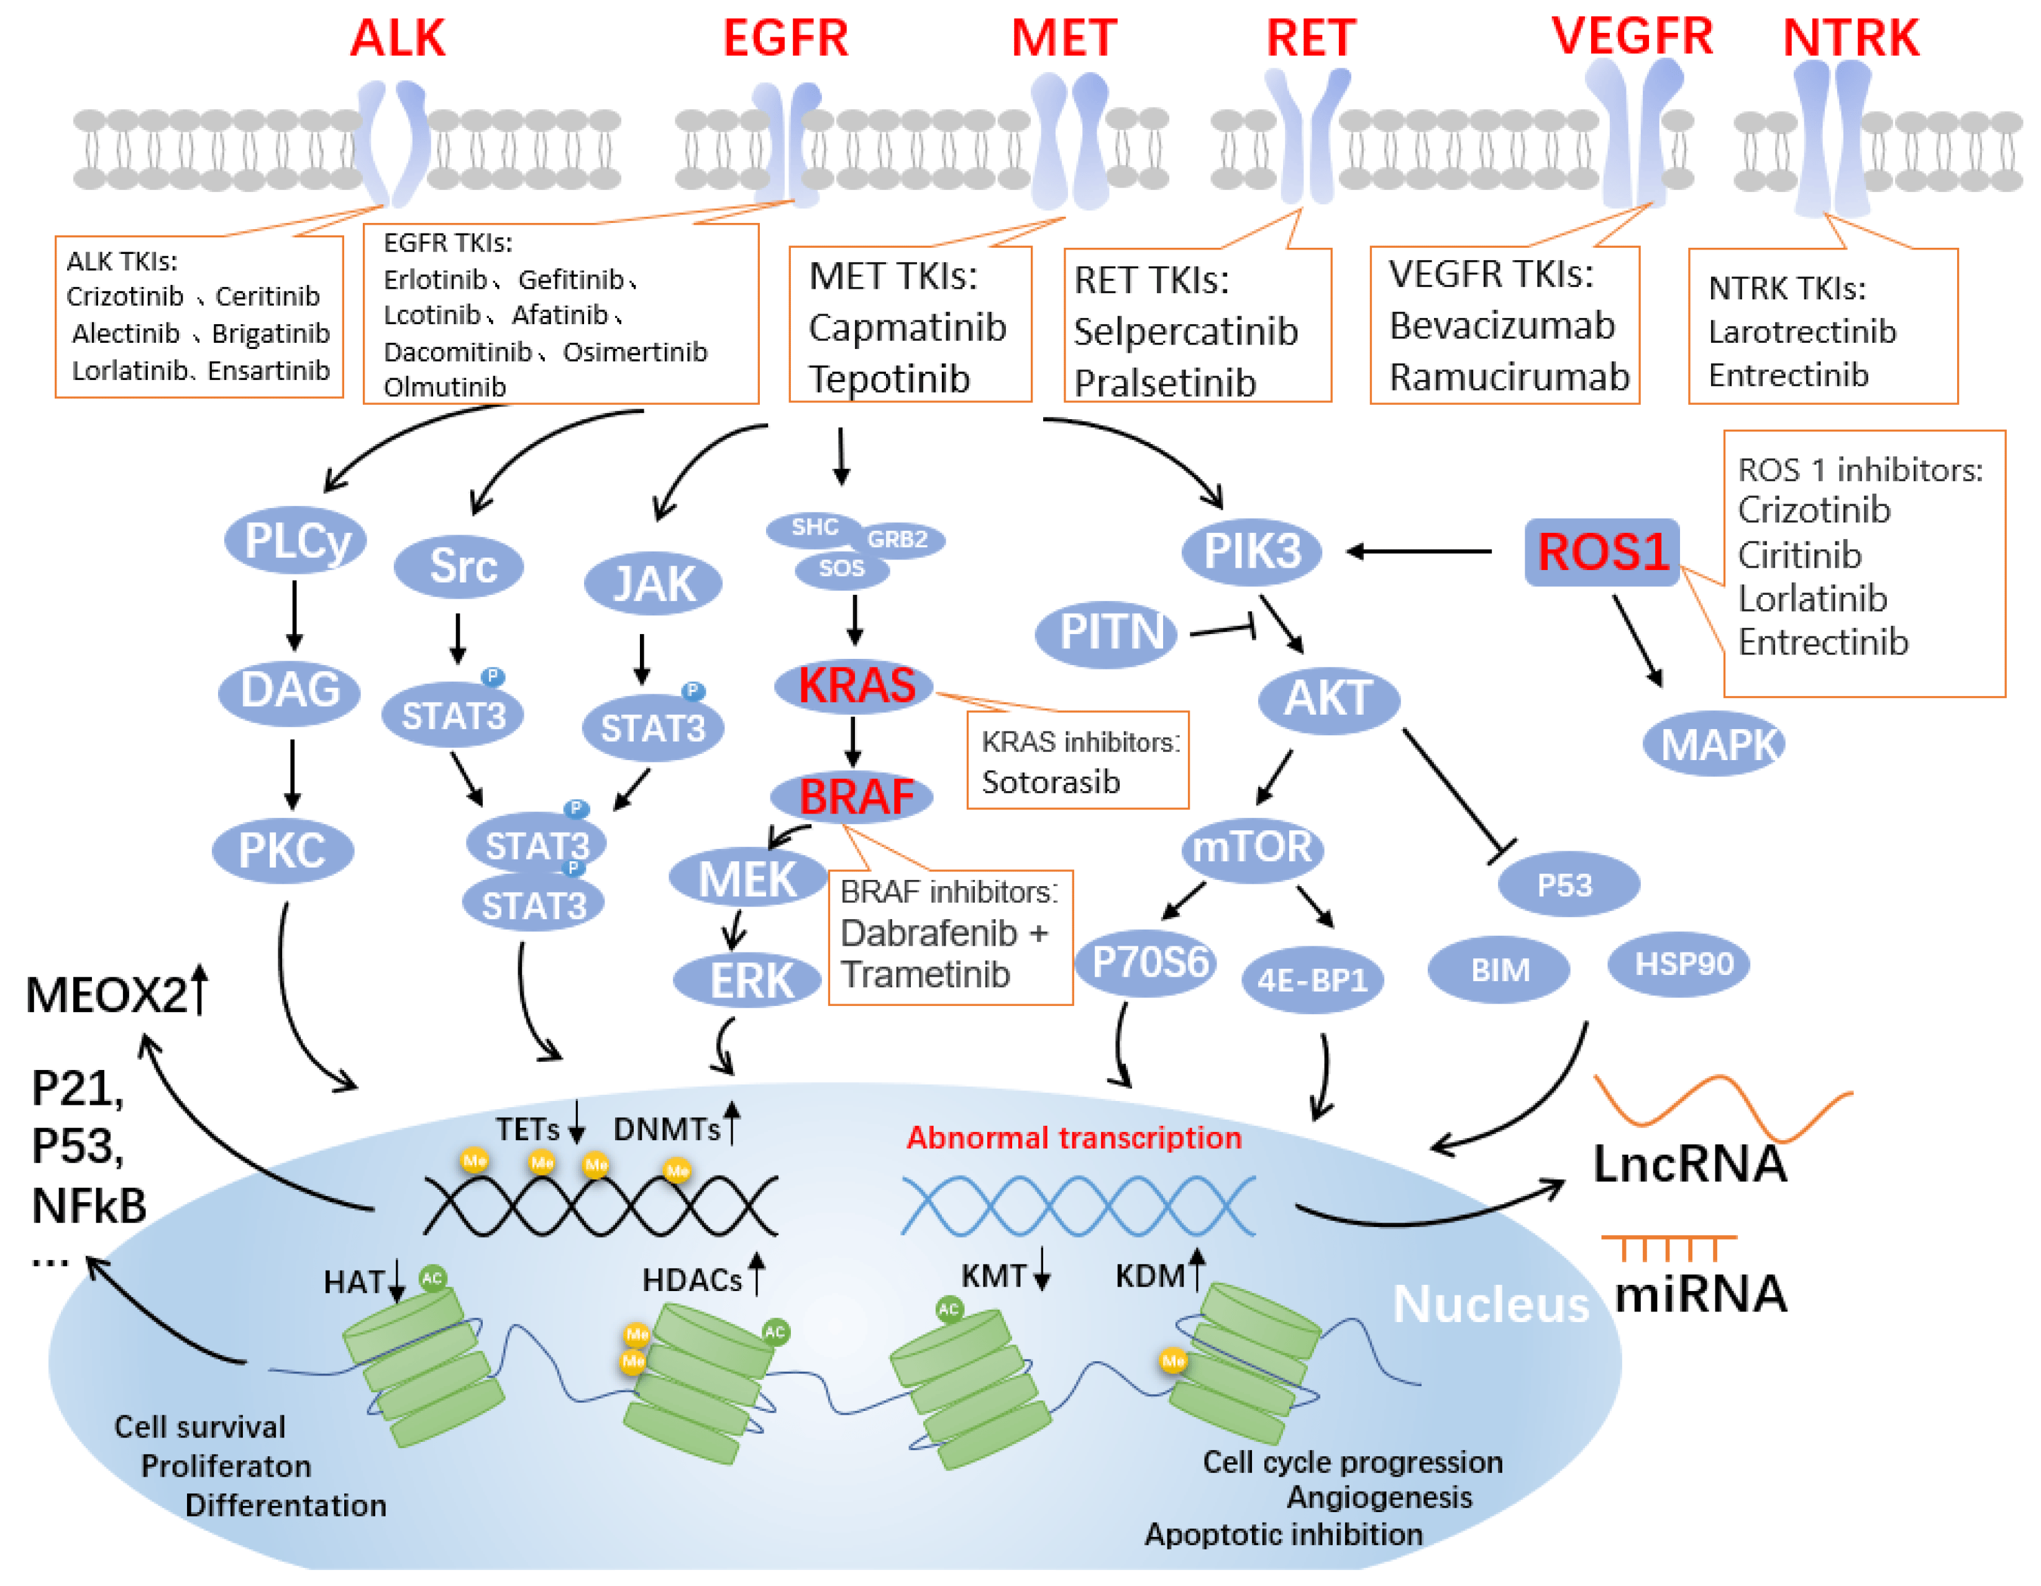
Which genes should be targeted?
Wu, et al., Int J Mol Sci, 2022

Slide 41

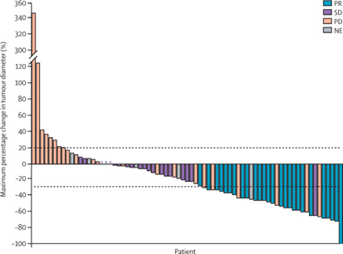
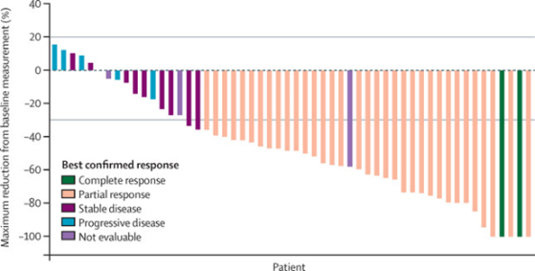
BRAF mutations
Clinical utility
  Single arm phase II data
  33% response for V600E to single agent dabrafenib
  63% response for V600E to combo dabrafenib + trametinib
Methodology
  Widely available single gene tests for melanoma only test V600E
  Half of BRAF+ lung cancers have non-V600E mutations
  Need to sequence additional hotspots/whole gene?
Planchard, et al., Lancet Onc, 2016

Slide 42

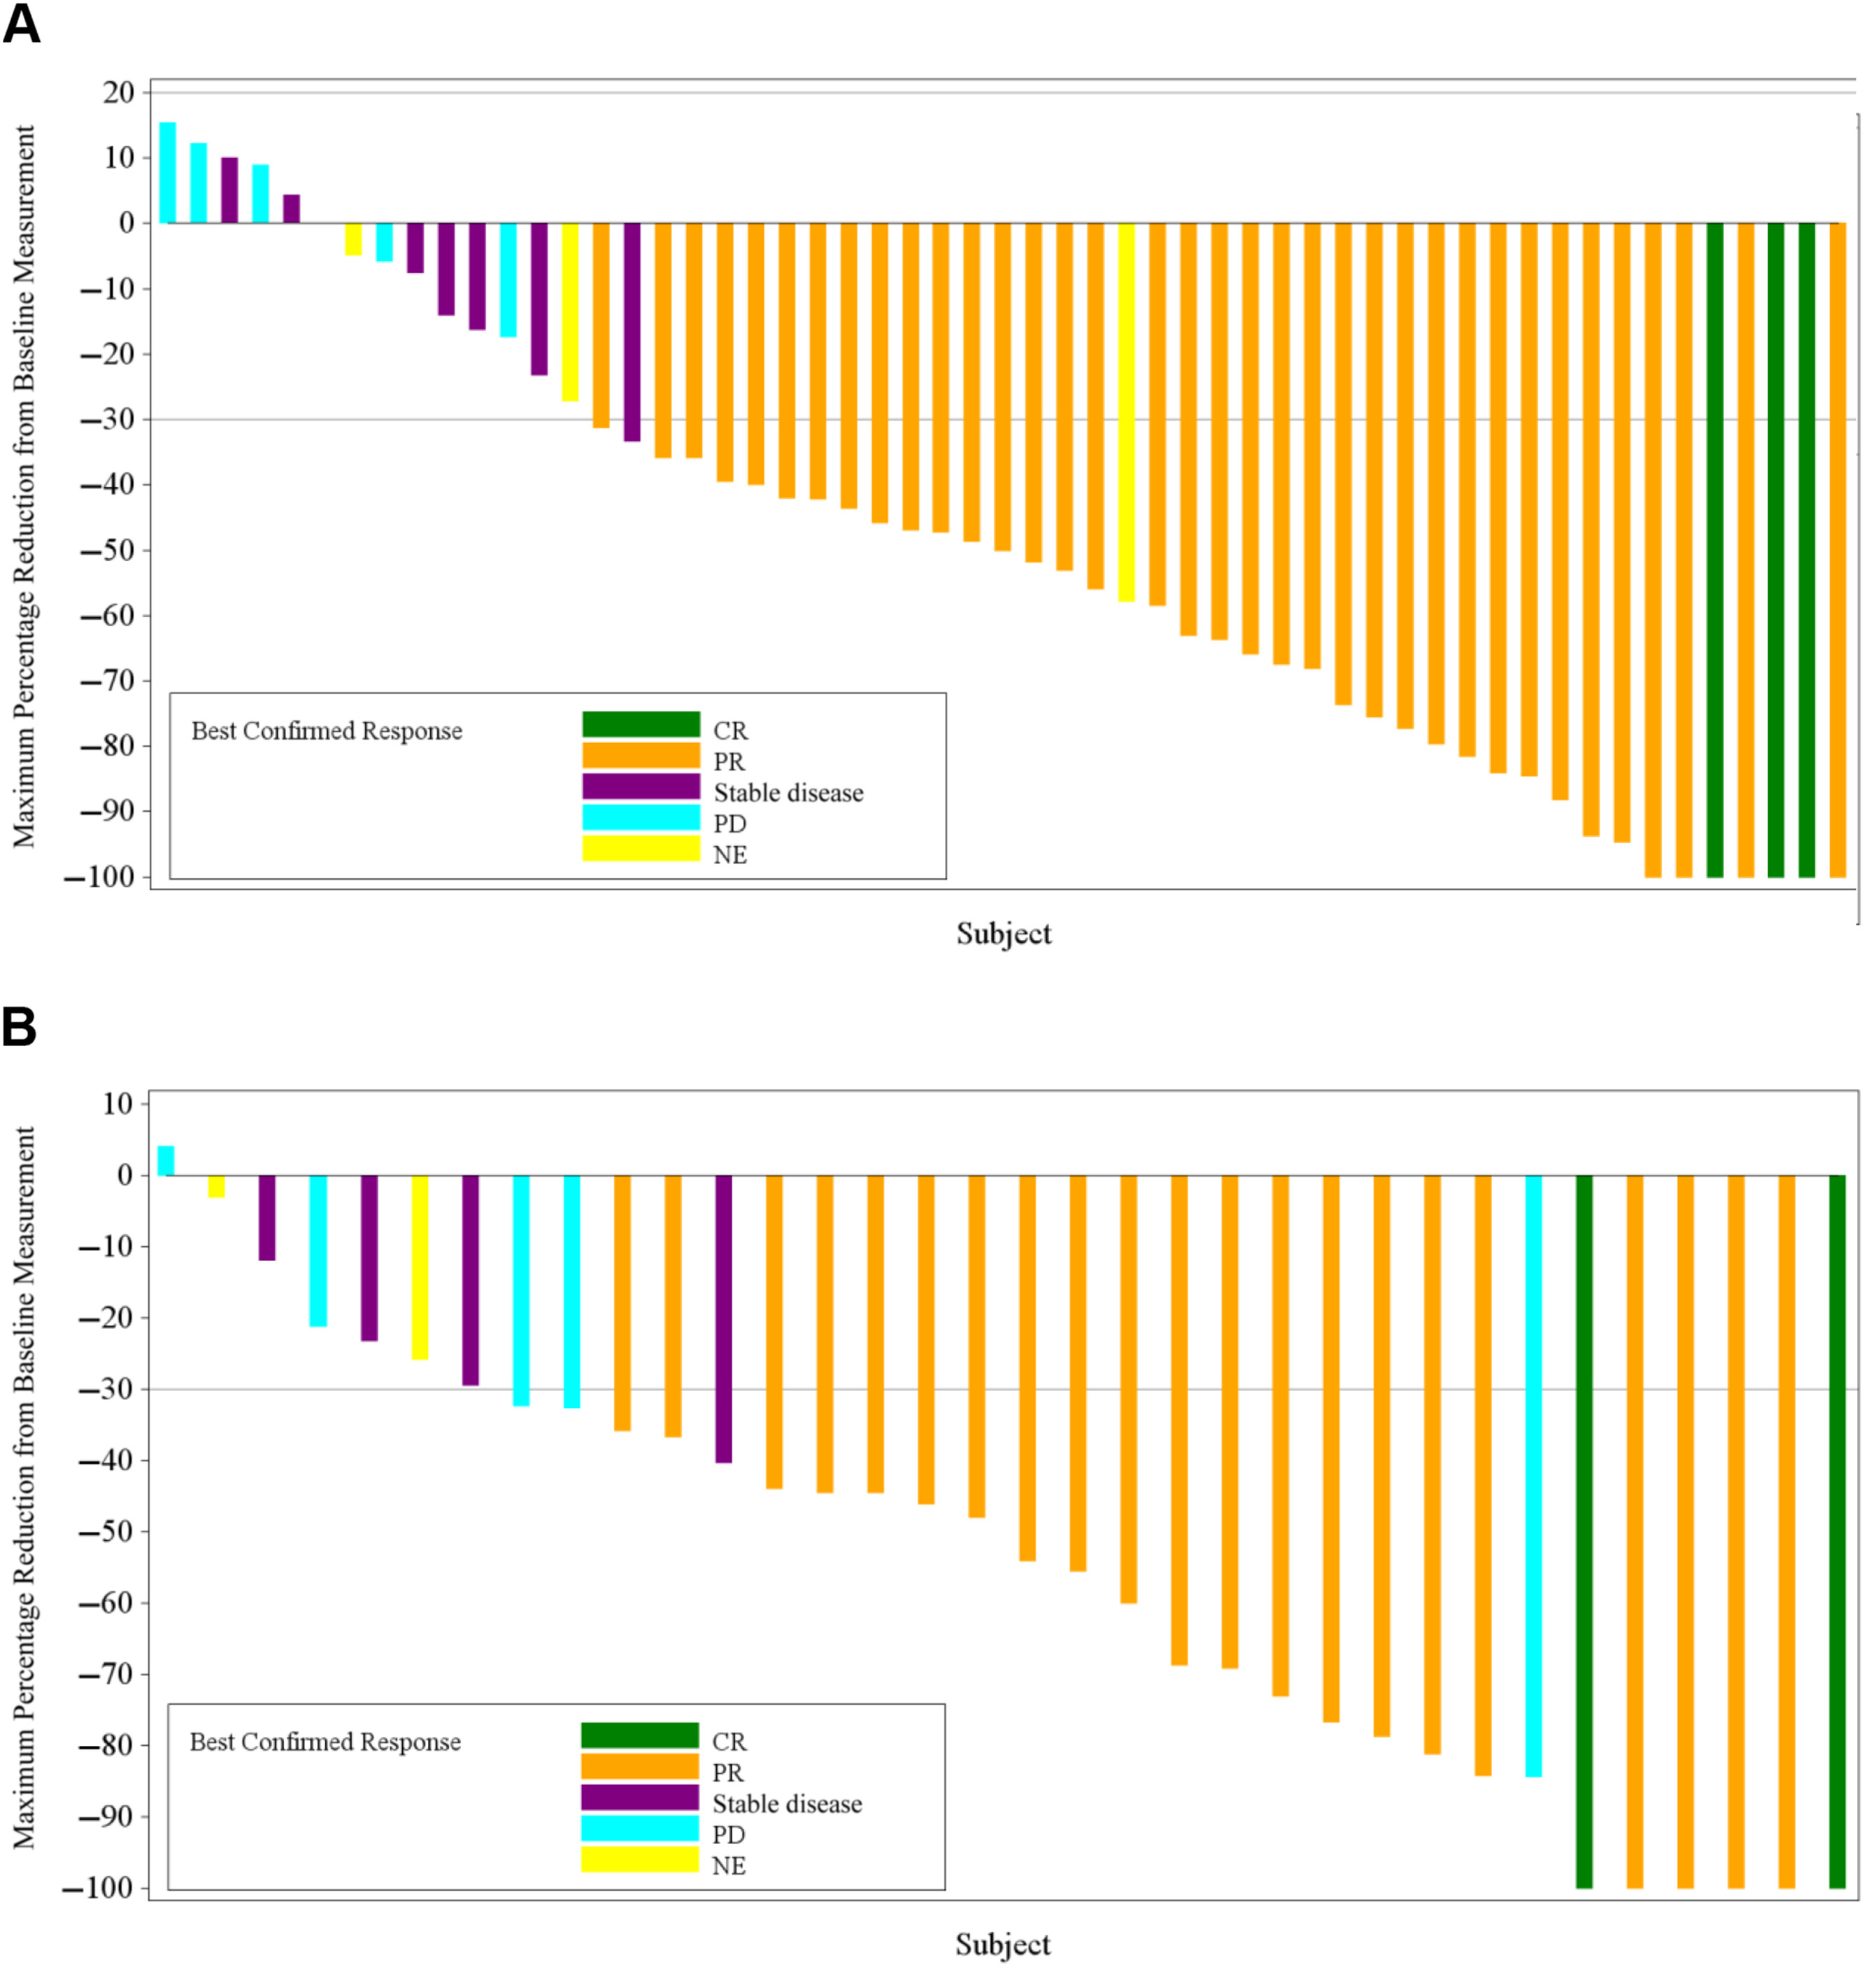
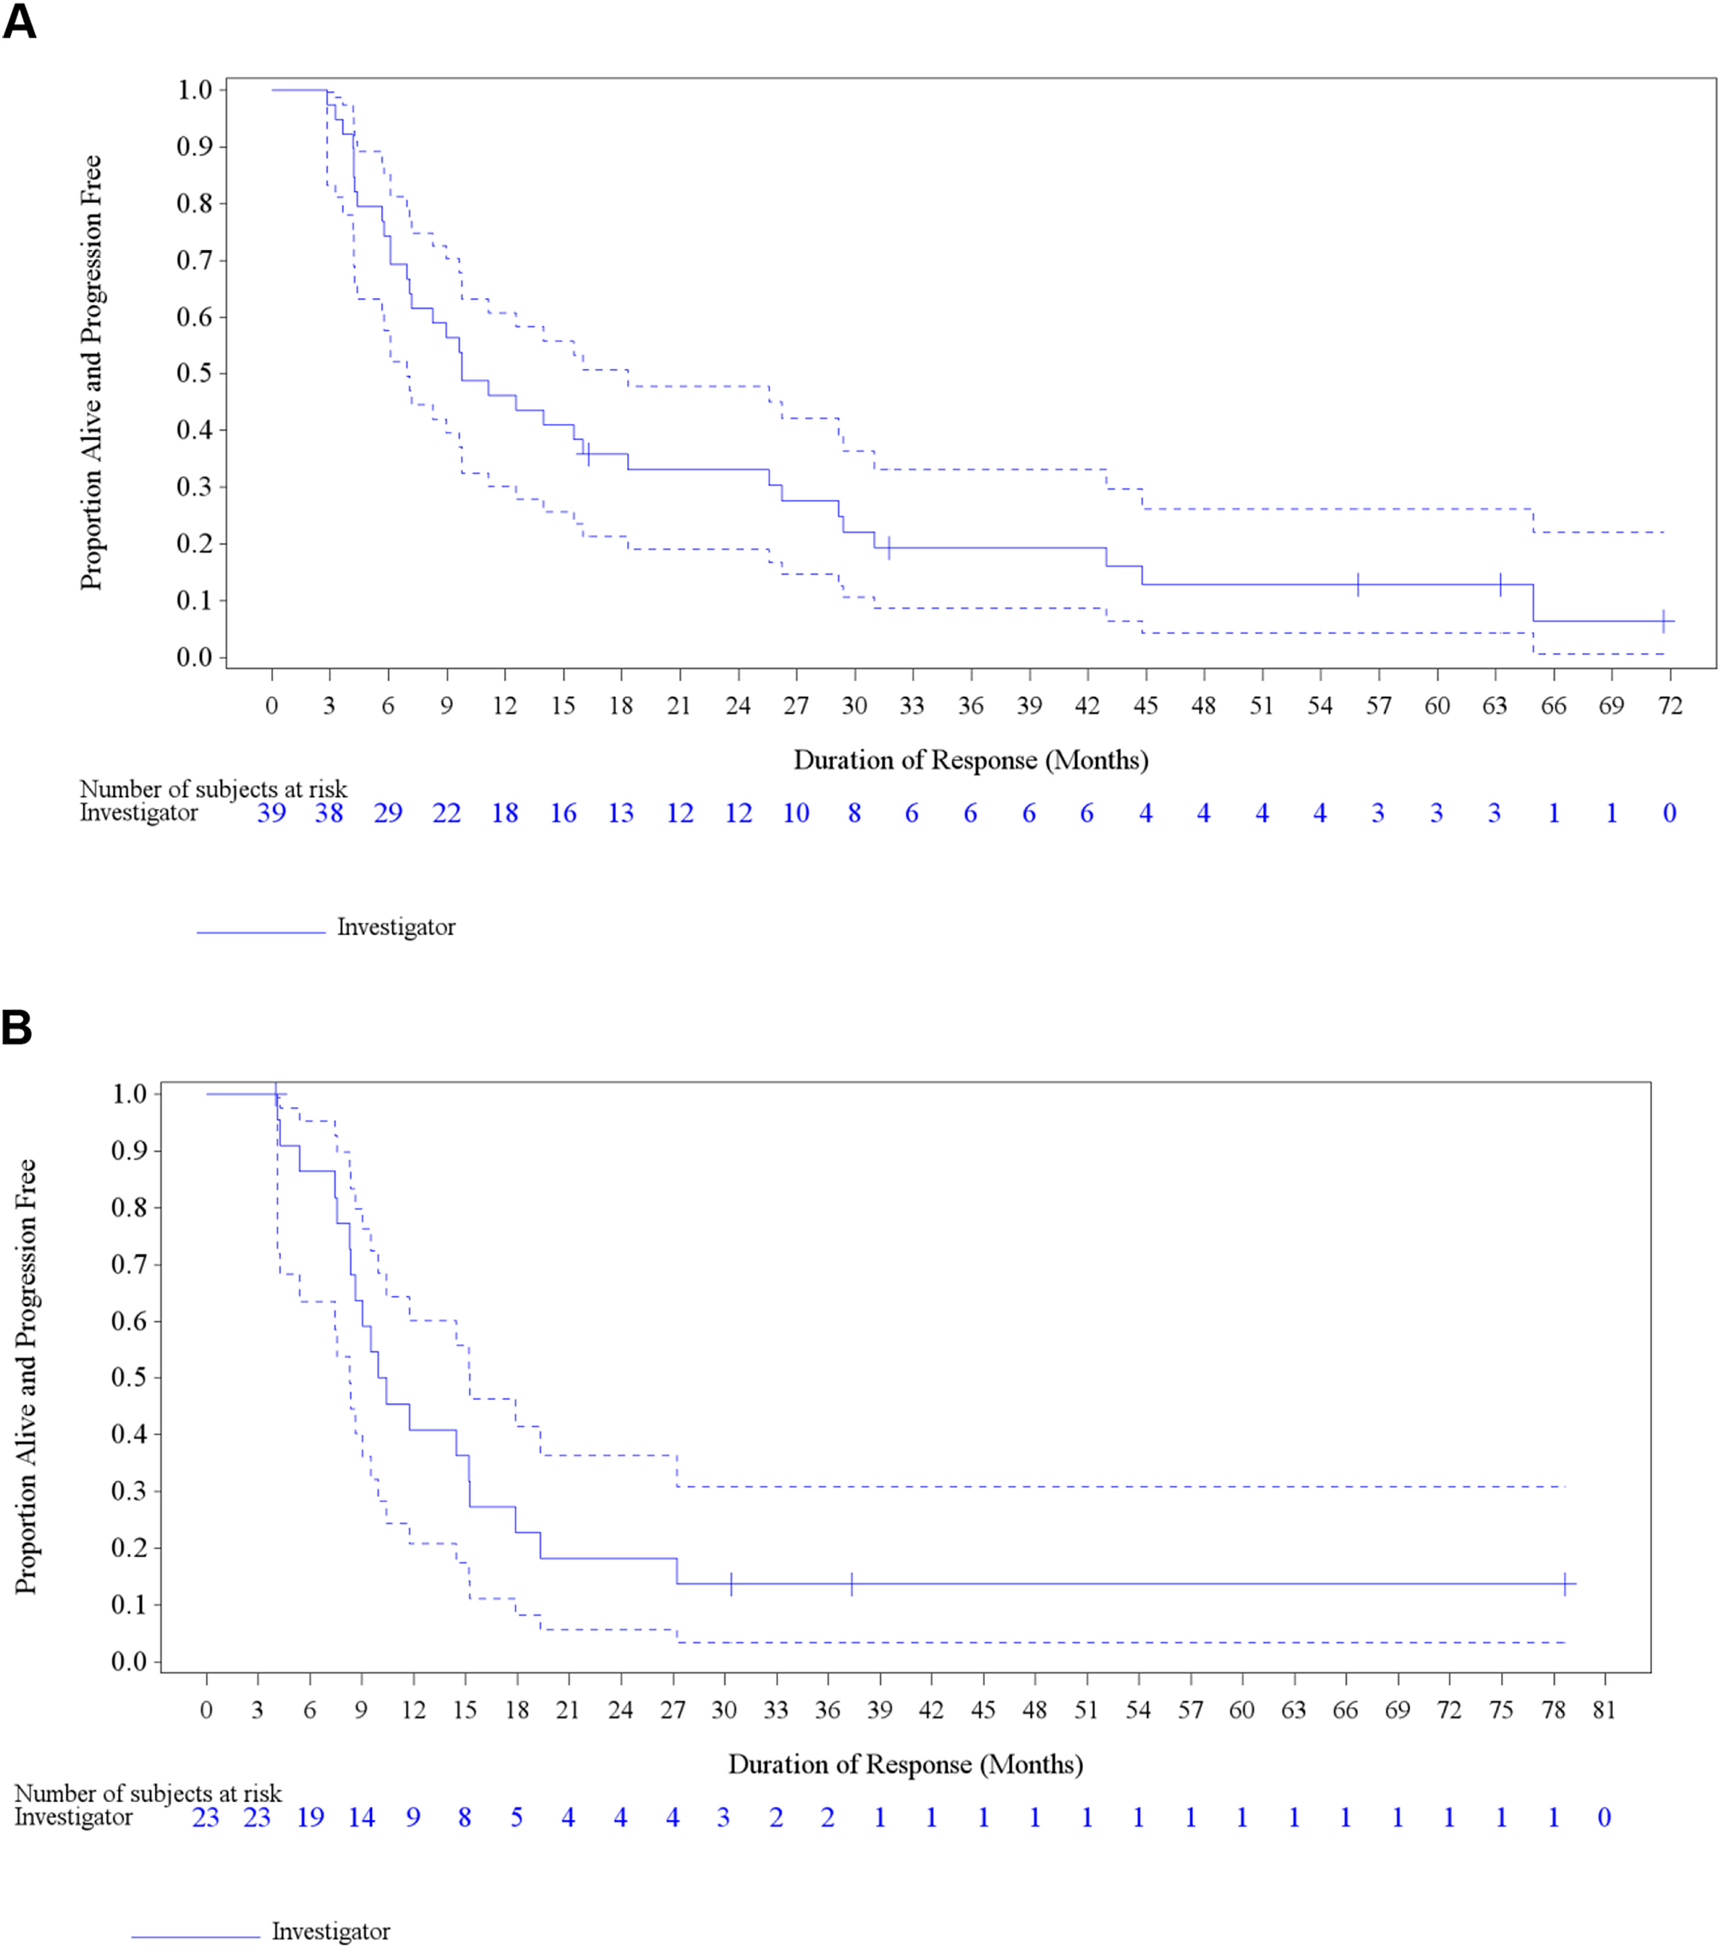
BRAF
Planchard, et al., J Thor Onc, 2022

Slide 43

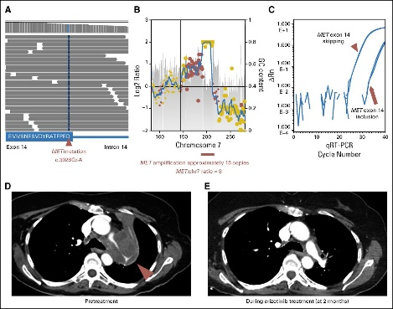
MET
Clinical utility - a complicated story…
  MET copy gain first seen in who relapsed on anti-EGFR therapy
    Confusion in frequency: “copy gain” vs “amplification”
    Can co-exist with other oncogene mutations
  MET inhibitors were developed (crizotinib), but didn’t work in general
    Rare “true” MET amplification does respond to crizotinib (~50% rr)
  Fast forward: NGS discovers mutations affecting splicing of exon 14
    Common: ~3% of lung cancers
    Exon 14 skipping mutations do respond to crizotinib
    Multiple additional inhibitors in development/trials
  Methodology: many choices still, but RNA probably favored
Awad, et al., JCO, 2016

Slide 44

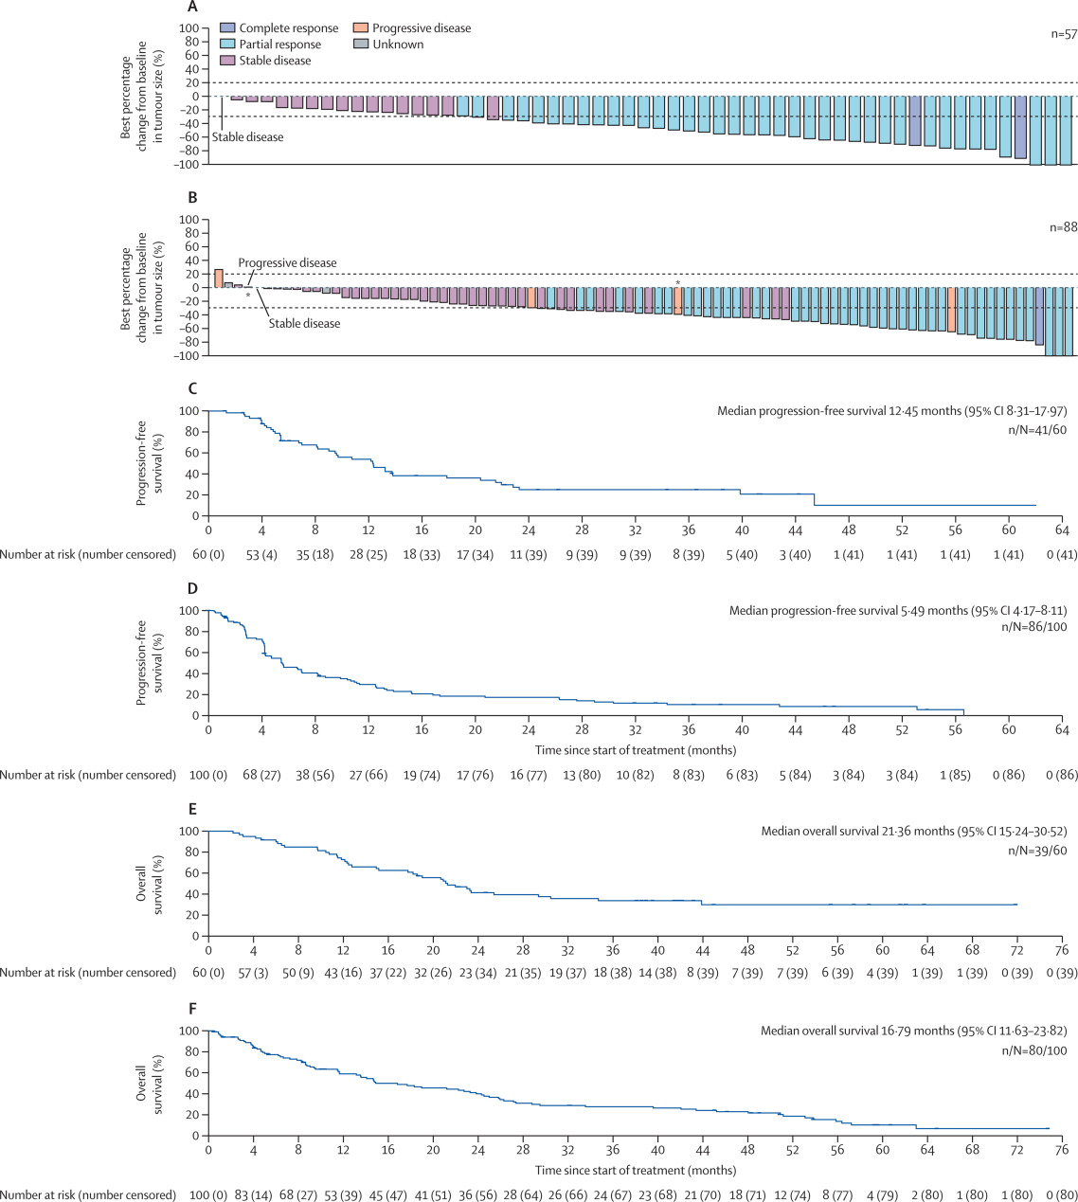
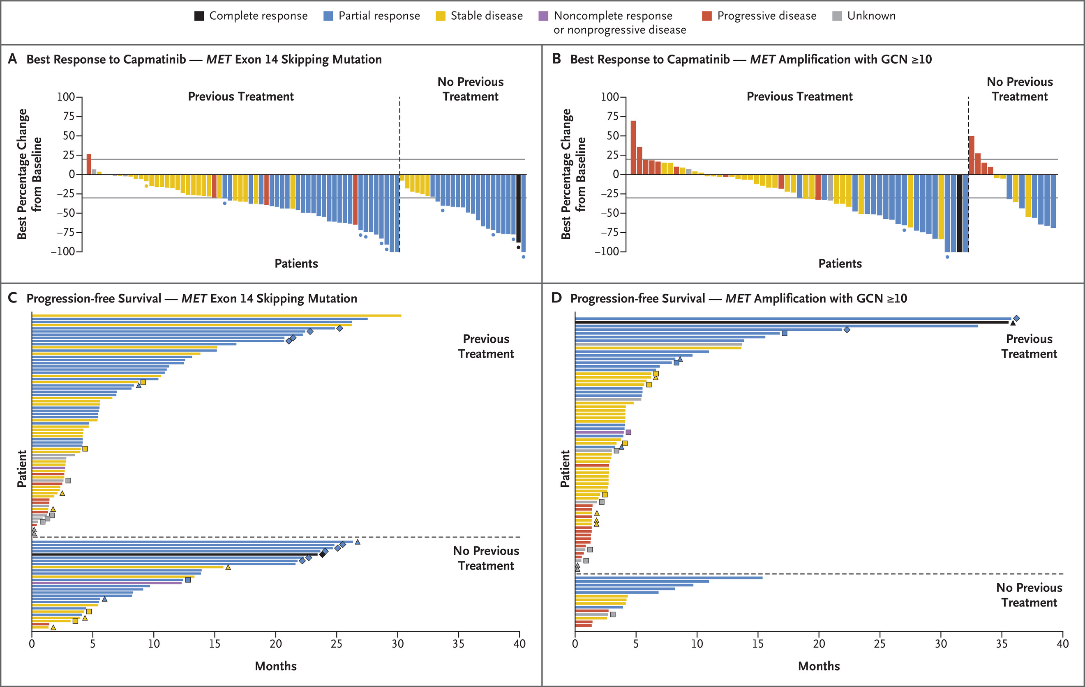
MET
Wolf, et al., NEJM 2020
Wolf, et al., Lancet Oncol, 2024

Slide 45

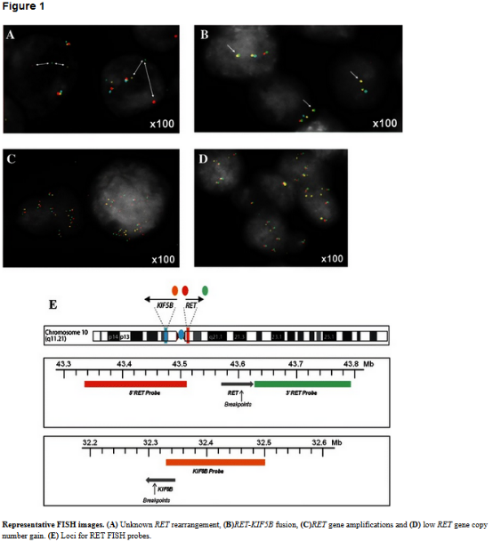
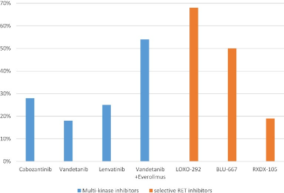
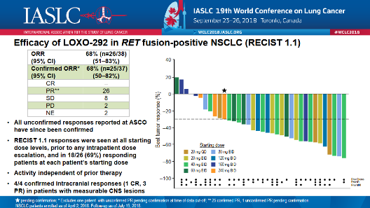
RET
Characteristic mutations in thyroid cancer
  Mutations in MEN II syndrome, medullary carcinoma
  RET/PTC fusions in papillary carcinoma
Overlapping alterations in lung cancer
  Multiple fusions, including KIF5B, CCD6, NCOA4
    Some of the same partners as ROS1…
Response to TKIs:
  Broad TKIs: ~30-50% ORR, PFS 5-8 mos
  Selective RET TKIs: 50-70% ORR, PFS 18.4mos
    Breakthrough designation: Sep, 2018
Methodology:
  Discovered by DNA NGS
  Unlike other fusions, FISH and IHC are challenging
Platt, et al., BMC Cancer, 2015
Ackerman, et al., Onco Targets Ther 2019
Oxnard, IASLC, 2018

Slide 46
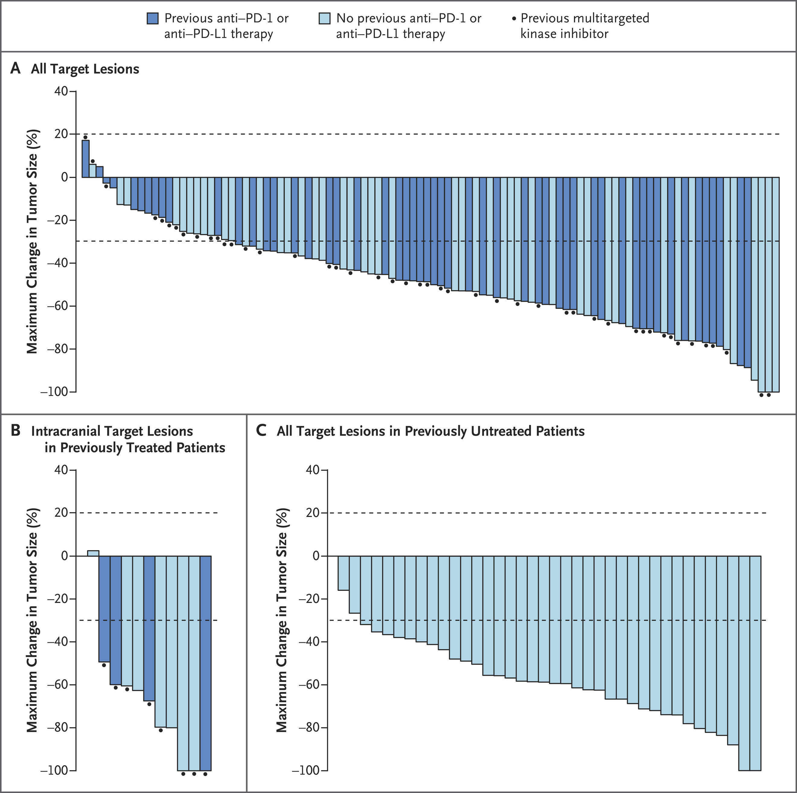
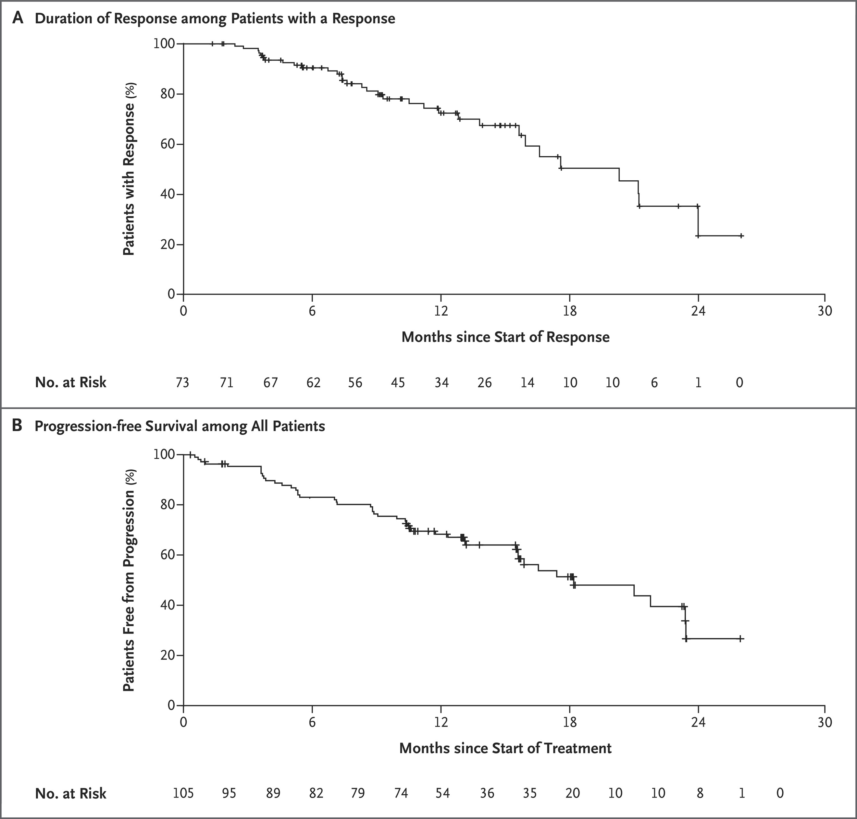
RET
Drilon, et al., NEJM 2020

Slide 47

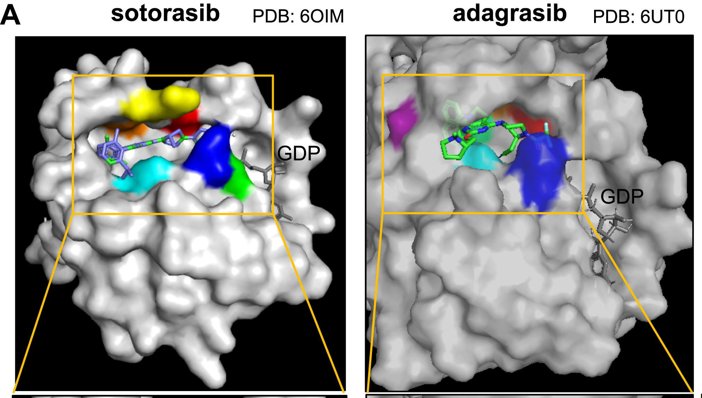
KRAS Mutations in NSCLC
Clinical utility
  No effective direct KRAS inhibitors
  Early reports of response to MEK inhibitors failed in phase III
  Associated with smoking
Useful to “rule out” other less common alterations
  30% of lung adenocarcinomas
  Simple and widely available single gene assays
G12C-specific inhibitors are effective
Koga, et al., JTO, 2021

Slide 48

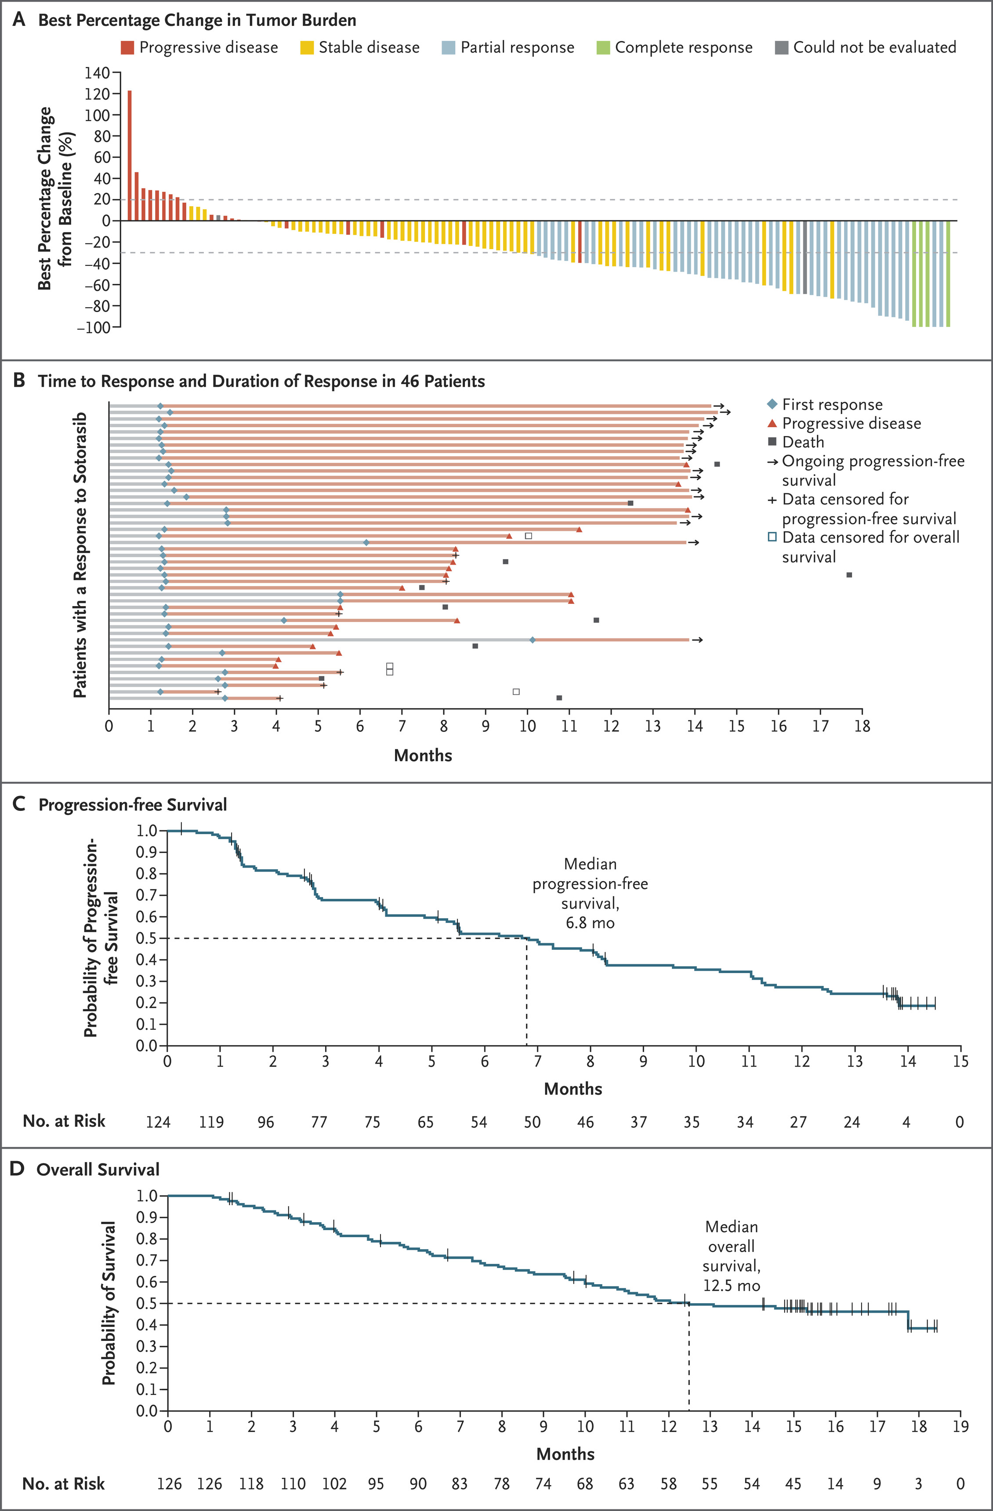
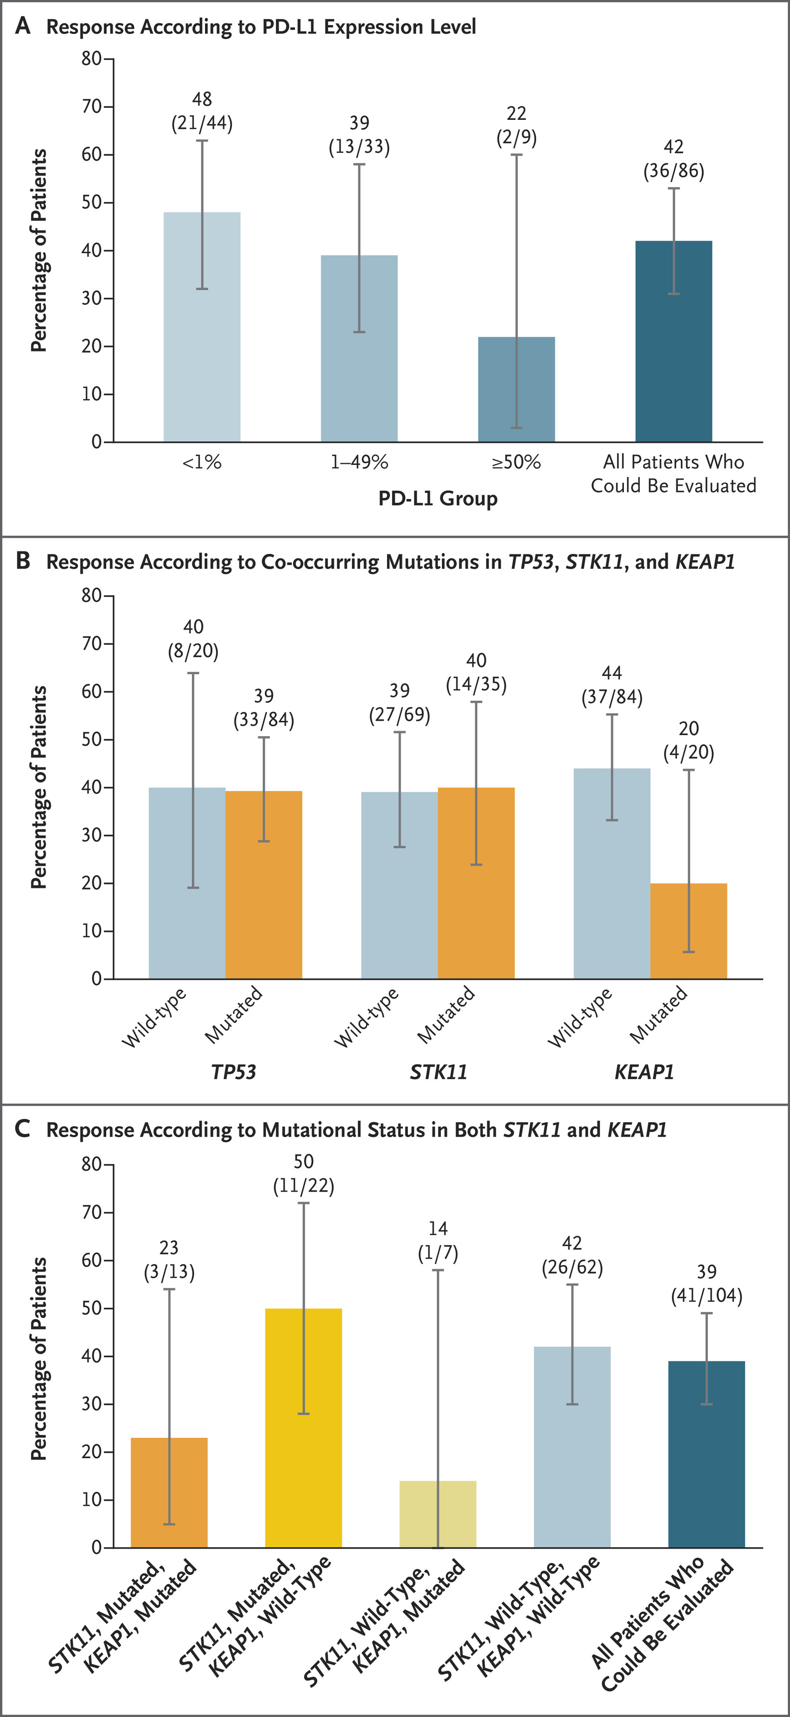
KRAS (p.G12C)
Skoulidis, et al., NEJM 2021

Slide 49

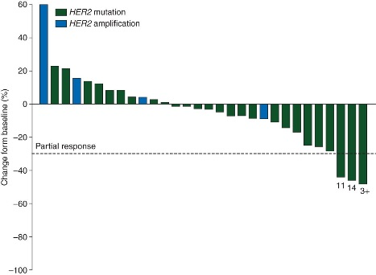
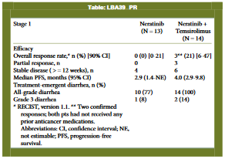
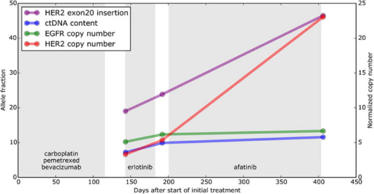
ERBB2 (HER2)
Critical gene in breast cancer
  Amplification (FISH) or overexpression (IHC)
  Responds to treatment with trastuzumab
Different role in lung cancer
  Mutations, typically insertions in exon 20
  FISH, IHC are not useful for lung cancer
  Do not respond to therapeutic antibodies
    Treatment with early TKIs disappointing
Kris, et al., Ann Oncol, 2015
Besse, et al., Ann Oncol, 2014
Chuang, et al., JTO 2017

Slide 50

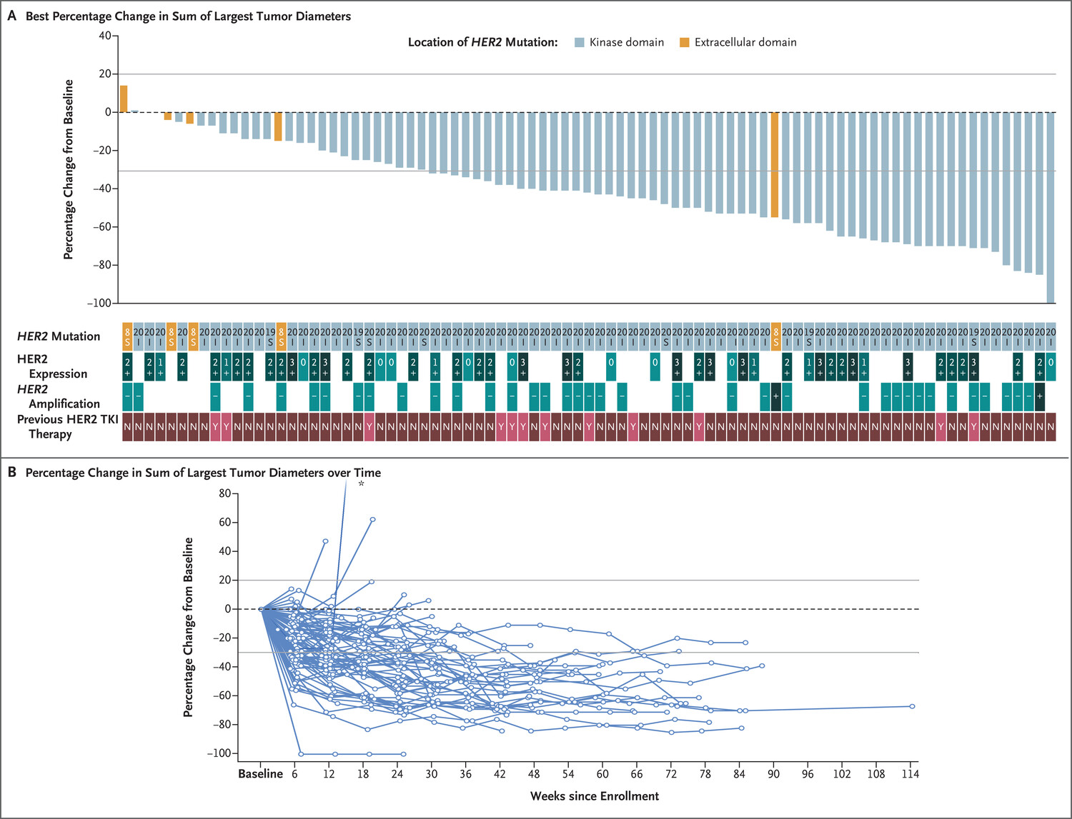
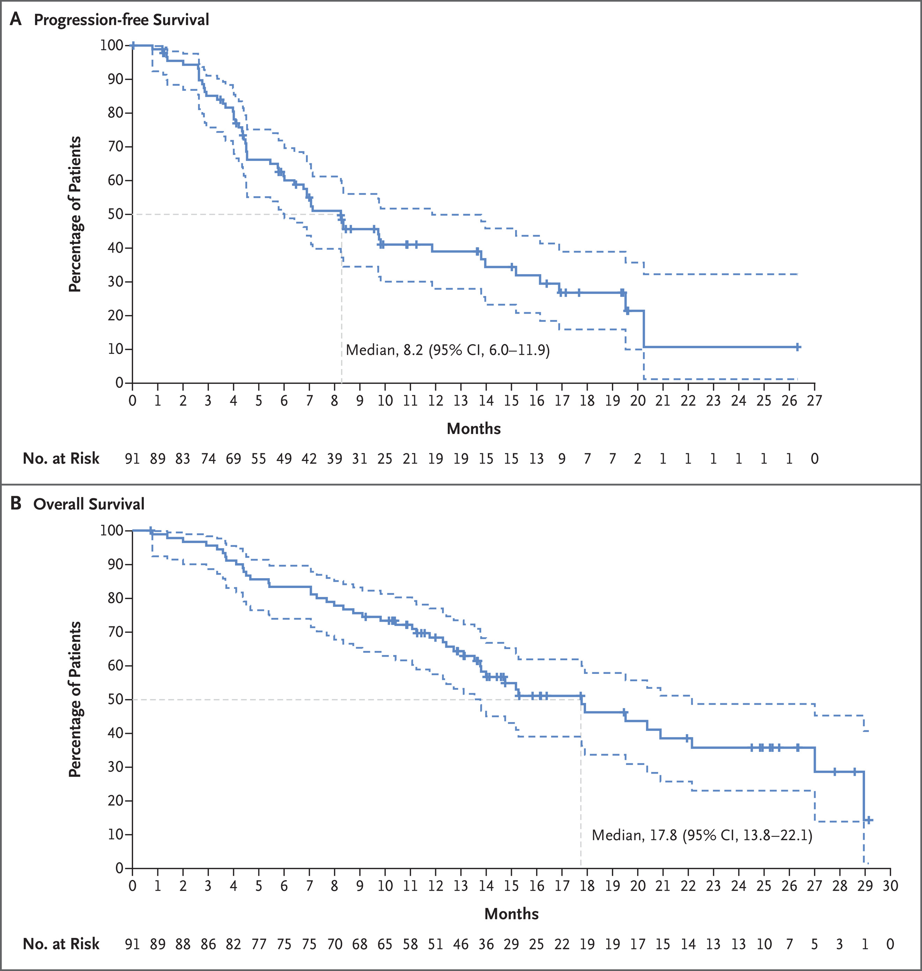
ERBB2 (aka HER2)
Li, et al., NEJM 2021

Slide 51

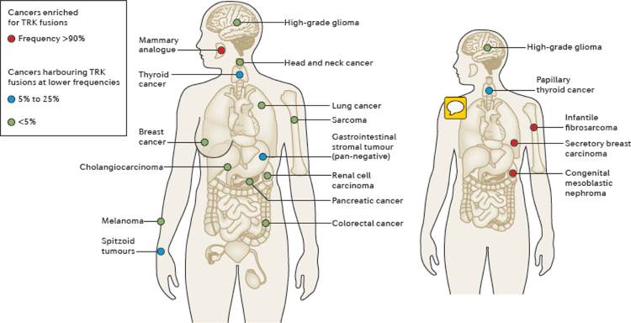
NTRK1-3
Fusions of C-terminal kinase domain to multiple partners
Ligand-independent dimerization → MAPK/PI3K/PKC pathway activation
Rare in lung cancers, but seen in multiple cancers
  ETV6::NTRK3 is a characteristic finding in some tumors
    infantile fibrosarcoma
    secretory carcinoma of breast or salivary gland
    congenital mesoblastic nephroma
RNA sequencing preferred for non-ETV6 fusions
  IHC: variable sensitivity/specificity by tumor type and fusion partner
  FISH: limited sensitivity due to intrachromosomal fusions (esp. NTRK1)
  DNA sequencing: long and repetitive introns
Coco, et al., Nat Rev Clin Onc, 2019

Slide 52



NTRK1-3
Cho, et al., Lung Cancer 2024

Slide 53





NRG1: Outdated before submission

Slide 54


NRG1
Neuregulin-1 is an ERBB3 ligand
  NRG1 binding → ERBB family heterodimers → MAPK, PIK3 activation
Activated by fusions
  CD74 most frequent partner, but many others
  Type III fusions remain anchored in membrane
    Ongoing autocrine/juxtacrine stimulation
Enriched in invasive mucinous adenocarcinomas
Fernandez-Cuesta and Thomas, CCR, 2016

Slide 55
Which cancers to test?
All advanced non-squamous non-small cell lung cancers
Advanced Squamous cell carcinomas may be tested based upon clinical considerations
At initial diagnosis and at time of progression
  Includes resistance testing
Early stage non-squamous non-small cell carcinomas:
  EGFR and ALK
  For determination of adjuvant, neo-adjuvant therapy

Slide 56


Early stage
Wu, et al., NEJM, 2024 (ALINA)
Wu, et al., NEJM, 2020 (ADAURA)

Slide 57


Squamous Cell Carcinoma
Jin, et al., Front Oncol, 2021
Lin, et al., Ann Oncol, 2020

Slide 58

EGFR-TKI resistance
Johnson, et al., Lung Cancer, 2022

Slide 59


ALK-TKI resistance
Koopman, et al., Clin Lung Cancer, 2022

Slide 60
How to test?
cfDNA when tissue not available or adequate, or for urgent TAT
  No evidence to support using instead of tissue, when tissue is available
Inconclusive evidence to support for/against using cfDNA for monitoring treatment response
DNA testing recommended
  RNA may be considered, especially if DNA testing is negative
  CHANGED based upon public commentary feedback:
    Now we recommend RNA, especially if DNA is negative

Slide 61

RNA
Benayed, et al., Clin Cancer Res, 2019

Slide 62
“Good practice” statements
TAT
Anatomic Path services should get sample to molecular lab within 3 days of completing diagnosis and receiving order
Testing should be completed within 10 days from receipt of sample in testing lab
Rapid testing (<5 d) for most prevalent biomarkers may be performed when clinically urgent, as long as it does not compromise full testing

Slide 63
“Good practice” statements methodology
NGS preferred over multiple single gene assays
Assays should be able to samples with >=20% cancer cells
  5% for resistance testing
IHC OK for ALK, screening for ROS
FISH OK for ALK
Testing multiple nodules OK for staging
No need to test multiple regions within a tumor

Slide 64


